Slide 1
MESH-CURRENT ANALYSIS
Date: 27-07-2020
Module 1: Fundamentals of DC Circuits
EEE 1024 Fundamentals of Electrical and Electronics Engineering

Slide 2
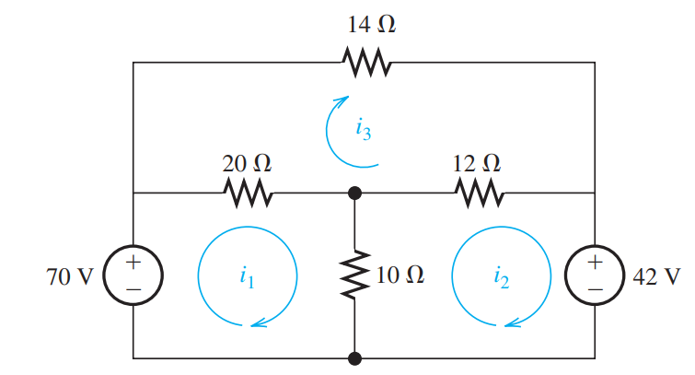


Example 1
Solve for the current in each element of the circuit shown in Figure

Slide 3
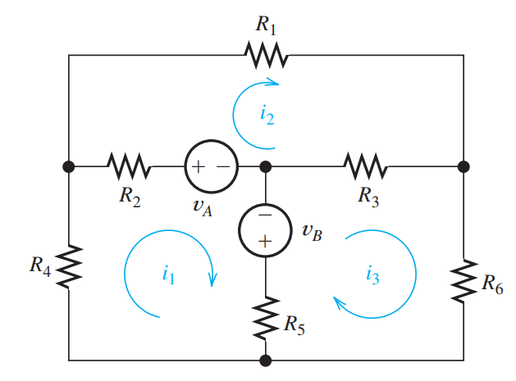
Example 2
Write Mesh-Current Equations in Matrix form

Slide 4
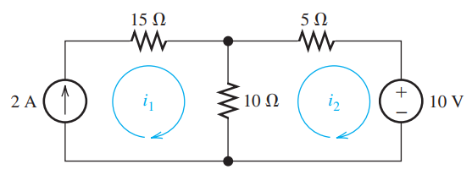
Example 3 - Mesh Currents in Circuits Containing Current Sources
Solve for mesh-currents

Slide 5
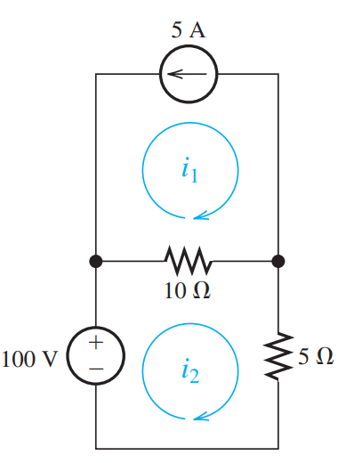

Example 4
Solve for Mesh Currents

Slide 6
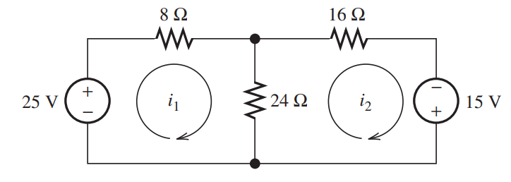
Example 5
Solve for the power delivered to the 24 Ohms resistor and for the mesh currents shown in Figure

Slide 7
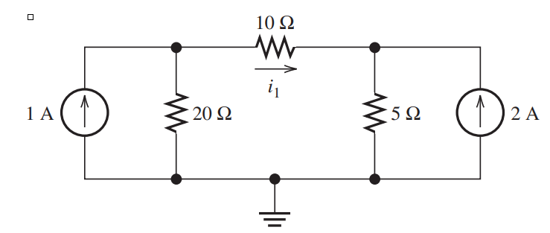
Example 6
Use mesh-current analysis to find the value of i1 in the circuit of Figure

Slide 8
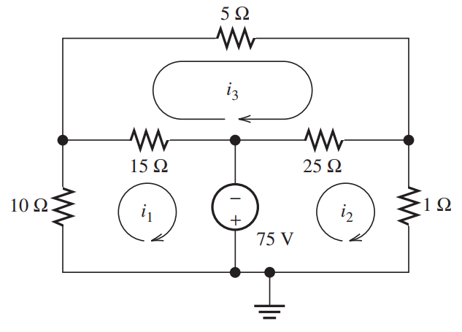
Example 7
Solve for the power delivered by the voltage source in Figure, using the mesh current method.

Slide 9
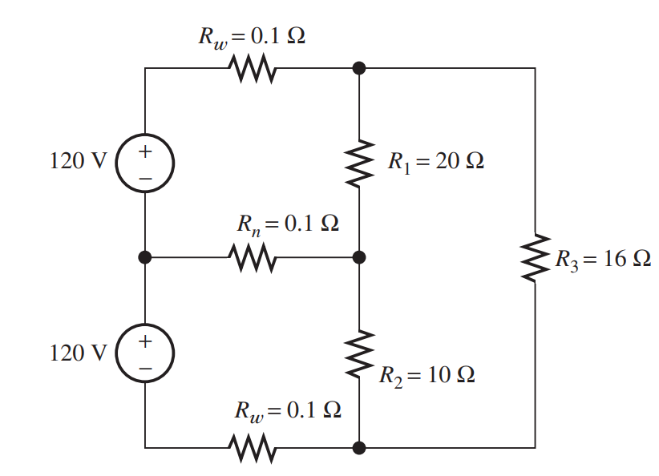
Example 8
Use mesh-current analysis to determine the voltage magnitude for each resistor

